Slide 1
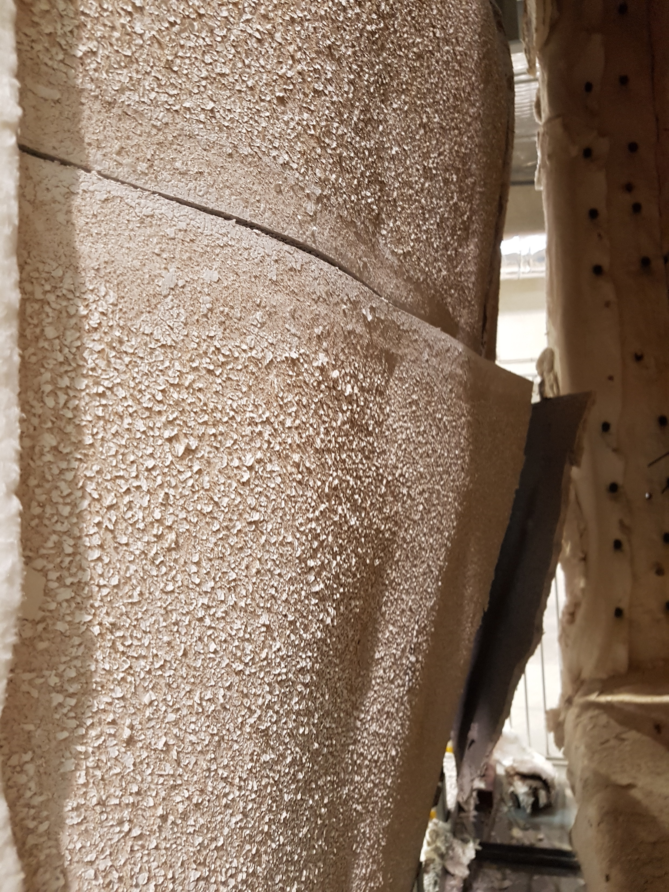
Fire Side
Plasterboard
Open Up

Slide 2
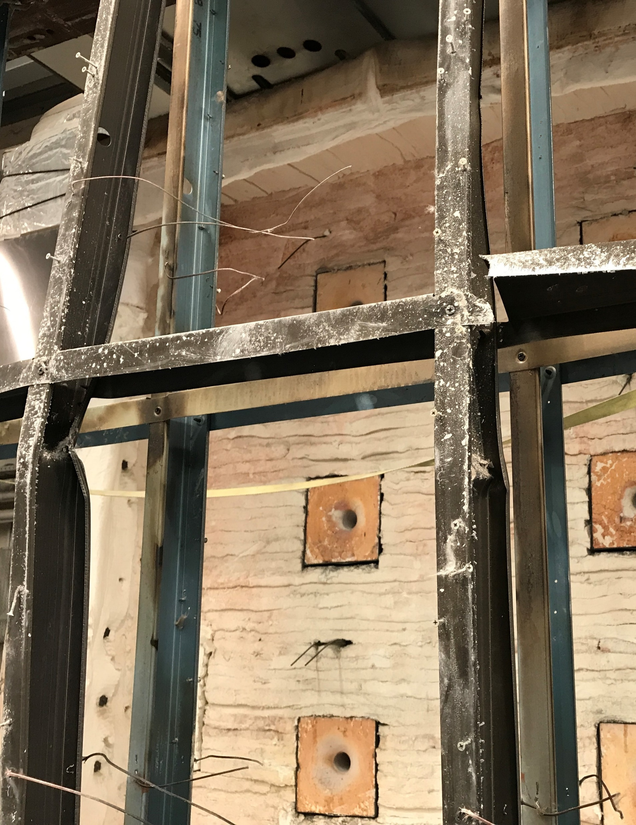
Buckling in Studs

